Slide 1
College Registration System
-PRESENTED BY-
Kshitij Jain (2018BCS-026)
Sakshi Rai (2018BCS-046)
Tanay Saxena (2018BCS-055)

Slide 2
Overview of the initiative
The foremost objective of carrying out this project is to minimize and eliminate the manual errors caused by the physical handling of the documents during the process of the registration.
Using a digital platform to perform the tedious operations proves to be much more efficient and productive as compared to the foregoing procedures.
Handling such an extensive paperwork of over a lakh students is not only a wasteful and unnecessary task, it also proves to be hazardous in these times of environmental crisis.
Hence, our initiative not only reduces the manual effort, makes the registration system error-free, but also proves to be eco-friendly, as a plus point!

Slide 3
What’s more feasible than a simple .cpp file and a-TB-or-two of memory?
This entire student registration system is nothing but a chunk of code, framed into a tiny part of the computer memory.
It can be handled and manipulated without any extensive prior knowledge, because we’ve put in a very basic interface, so that it can easily be added and incorporated into the pre-existing structure.
What does a terabyte or two of memory costs these days! Yes, our system can be fully functional in just that! Pretty cheap, huh?

Slide 4
Functions Of The Classes
There are 9 inherent classes in our project:
PERSON:
Person class contains the general information about a person. It is an abstract class and is inherited by 2 other classes.
STUDENT:
Student class will handle the details of a student. This class is inherited from Person class.

Slide 5
Functions Of The Classes (contd.)
STAFF:
Staff class will contain the information of the staffs working in an institute. This class will inherit from Person class.
REPRESENTATIVE:
This class will contain the information of the representative from each institute for the registration process.
INSTITUTE:
The Institute class will contain the information about the institutes the students are enrolling into.

Slide 6
Functions Of The Functions (contd.)
TEACHING:
This class will handle the details of all the staff which is working as professors/lecturers in the institute. It is inherited from the Staff class.
NON-TEACHING:
Non-Teaching class deals with the details of staff who does not come under the Teaching category( i.e. someone who is not a professor). It is inherited from Staff class.
BRANCH:
Branch class contains the information of a branch which is supported by the institute.
FEE:
Fee class contains the total fee for the different institutes for the various branches.

Slide 7
CLASS DIAGRAM NEXT

Slide 8
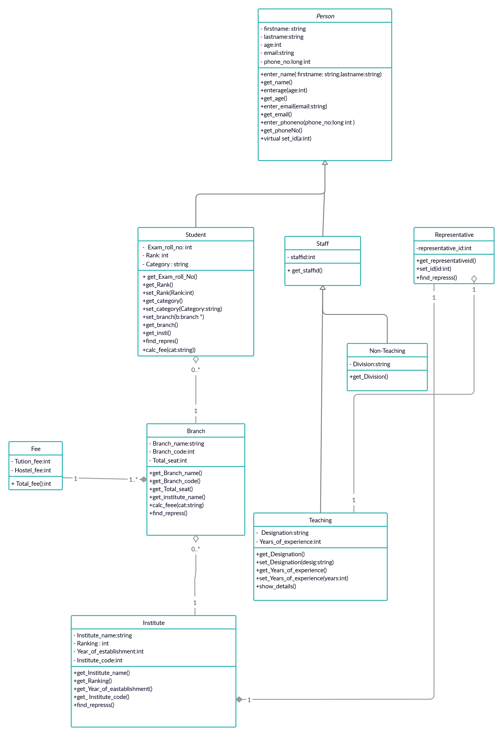

Slide 9
CONSIDERATIONS
PERFORMANCE:
Since this project is being implemented in C++ using OOPs on a local system and the g++ compiler, the execution time of the program will be very fast, even when the number of records increase.
Since every function would be processed on a computer, the manual errors would be diminished and the system would become fool-proof.
Minimal bandwidth and server space is required for the functionality of the college registration system.

Slide 10
CONSIDERATIONS (contd.)
SECURITY:
Since the system is implemented using the encapsulation features of the Object Oriented Programming in C++, with an efficient usage of private and public data members and member functions, the access to the sensitive information will be limited only to the concerned and designated authorities and the students themselves, thus ensuring a proper privacy and security of the data.
USABILITY AND EASE OF USE:
The interfaces are designed to make it easy for any potential user to get familiar with the system in no time.
No additional training is required to use the system, neither to the students, nor to the respective authorities involved in the procedure.

Slide 11
CONSIDERATIONS (contd.)
CAPACITY AND SCALABILITY:
This OOPS project can easily be integrated to any technology or web-based domain and will function equally well in any kind of a system as it doesn’t require a strong processor to get implemented.
MAINTAINABILITY:
This project will be easy to maintain as it is only required for the involved authorities to install the system just once and it will be available to them henceforth, with little or no requirement to ensure its proper functioning, because it is a simple configuration based on OOPs concept using the C++ language.

Slide 12
THANK YOU

